Slide 1
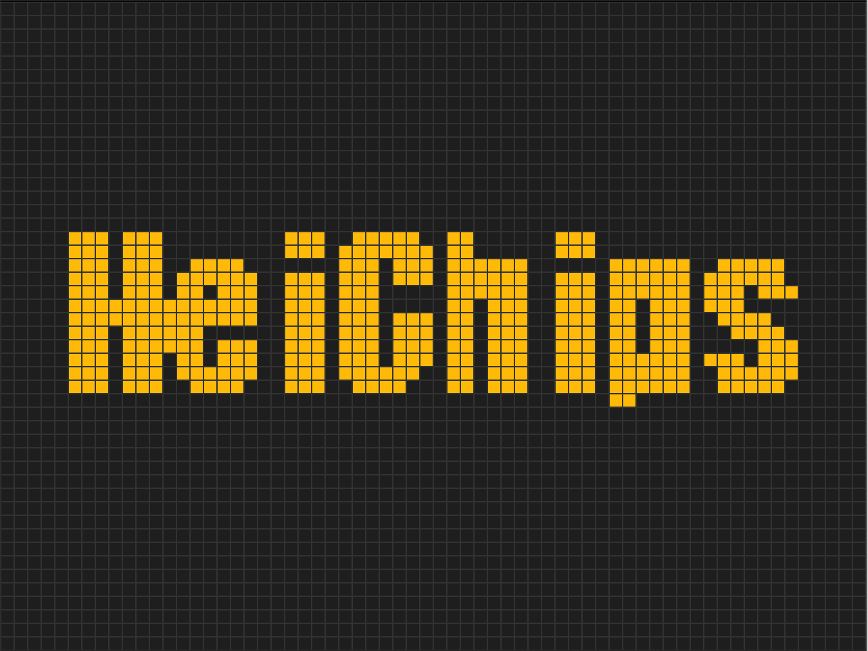
bAG O’ Life
bAsic Game Of Life
(with a bonus HDMI output)
Jan Zielasko, Graeme Bragg, Alice Ziuziakowska,
Hossam Omar, Pascal Gesell

Slide 2
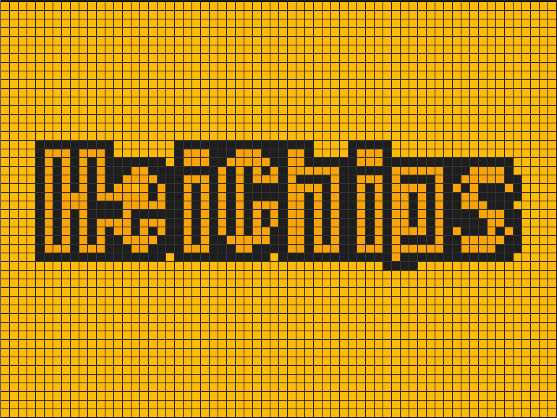
Project Idea
Conway’s Game of Life in an ASIC with a HDMI output would be cool
Videos reproduced from https://experiments.withgoogle.com/conway-game-of-life

Slide 3
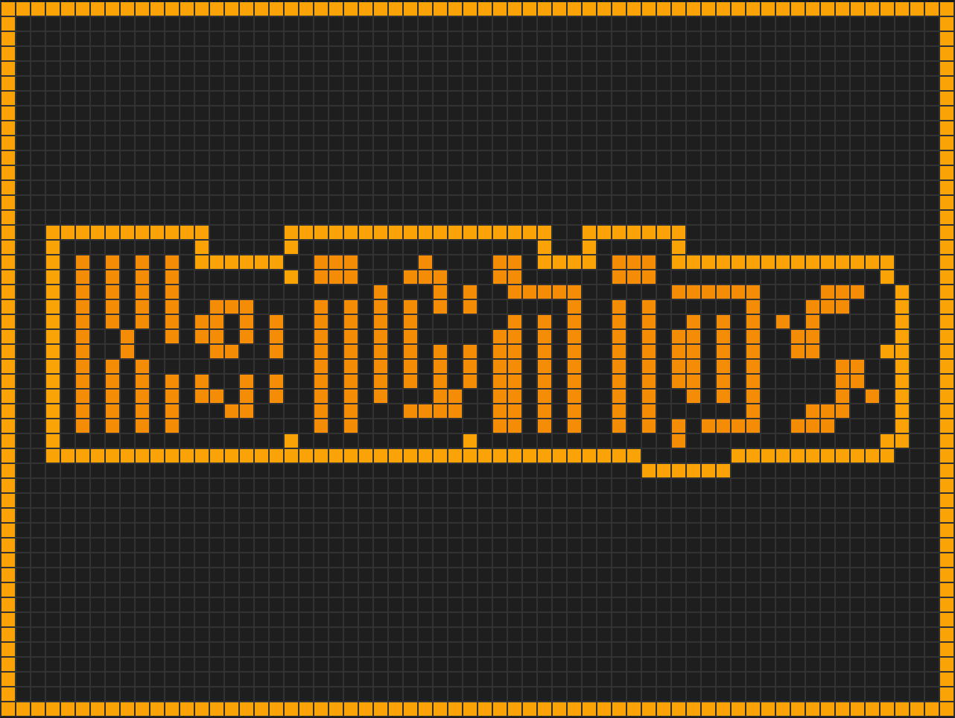
Project Contributions
Implemented a HDMI output in ASIC.
Added Tang Nano 9K FPGA support to the template (yes, there is a pull-request).
Showed that mixed language (SystemVerilog + VHDL) works in the flow.
Implemented demonstration shaders.
Implemented memory interface & upscaling.

Slide 4
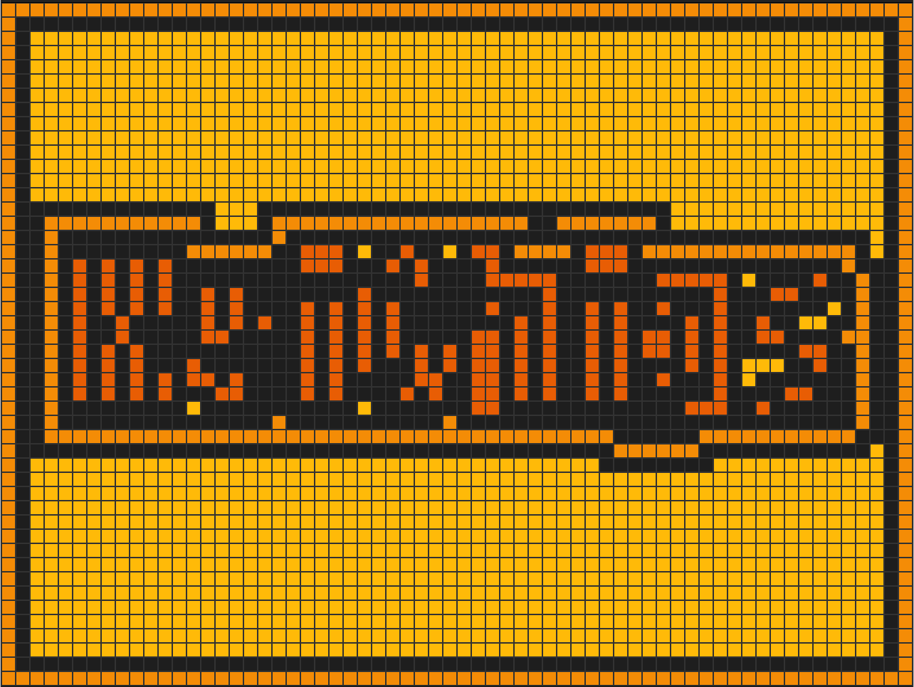
Challenges
HDMI is hard…
125 MHz clock
Double-data rate outputs
By-5 clock division…
So we have some hacks

Slide 5
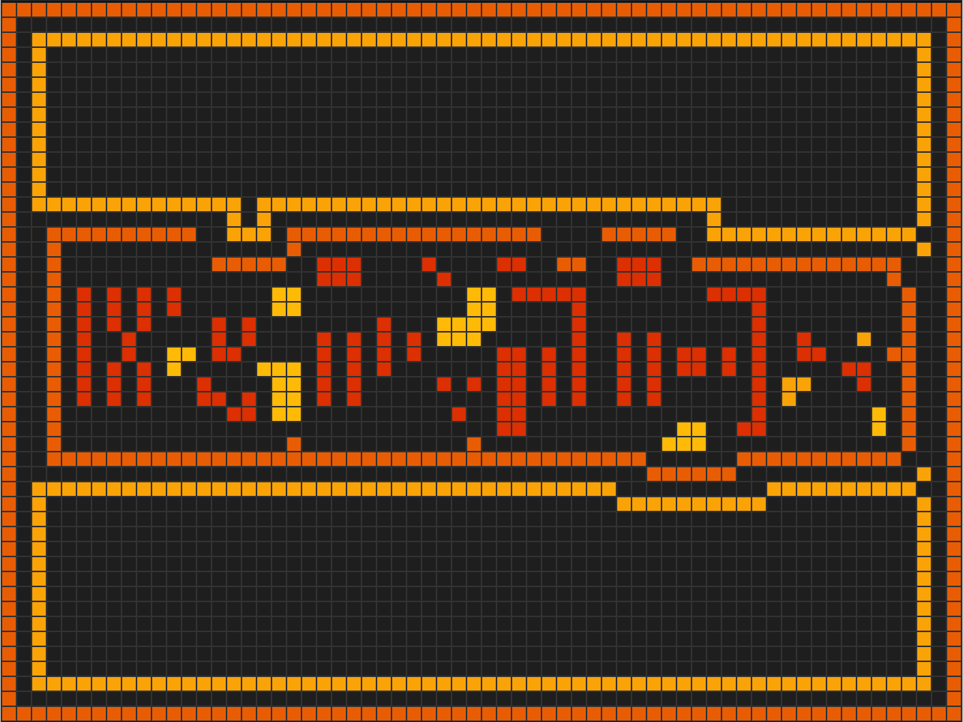
Converting Shaders is Also Hard
What we see during design is different once we convert high-level floating point operations to integer ops for hardware.
So much trial and error

Slide 6
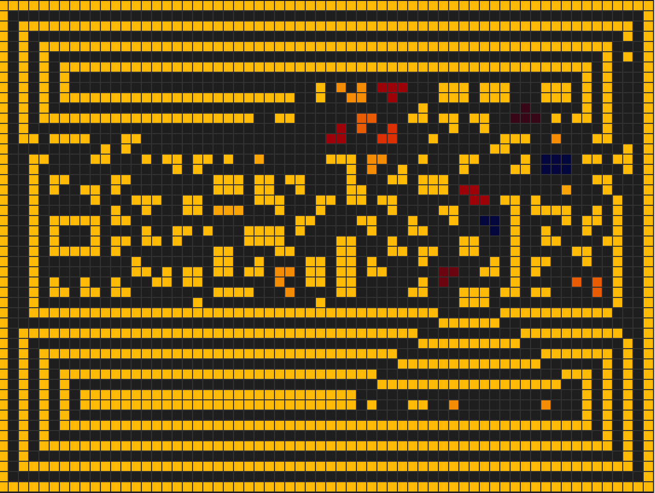
Verification
High-level design
FPGA Implementation
OpenRoad
Testbenches

Slide 7
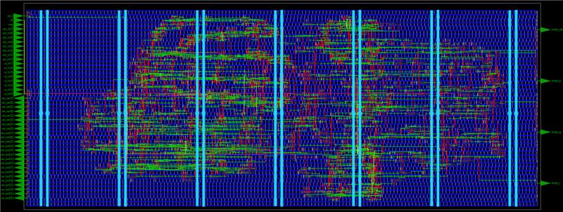

Slide 8
Any Questions?

